Slide 1

A.I
Part 3 - assignment
Ihssan Aljada – 18210011
Computer Information Science
4/2/2022

Slide 2

Problem
The data set that we have wasn’t categorized with genre as we wanted it to be

Slide 3
Aim and goals of the project
Train the AI to classify the models with the best accuracy

Slide 4
methods you used
Methods that were used importing the data then preprocess the data in order be able to work with that data to train the AI to predict the genres and the accuracy of prediction
Bag of Words
  Naïve bayes
  Logistic regression
TF-IDF
  Naïve bayes
  Logistic regression
Confusion matrix and LIME

Slide 5
Performance measure
The method that was used to solve the problem we had was using Confusion matrix
Also used LIME figures to measure the performance
And see the best accuracy between them

Slide 6
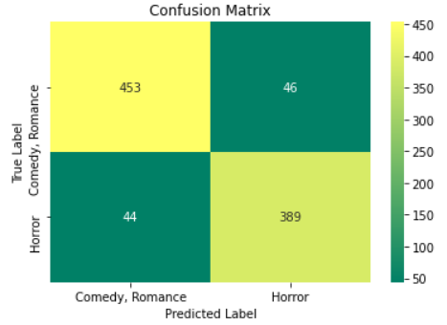
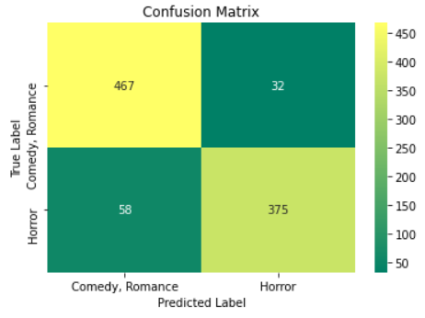
Comparing confusion matrices and classification accuracies
Naïve bayes – counter Vectorizer
Logistic Regression–counter Vectorizer
Horror and Comedy, Romance

Slide 7
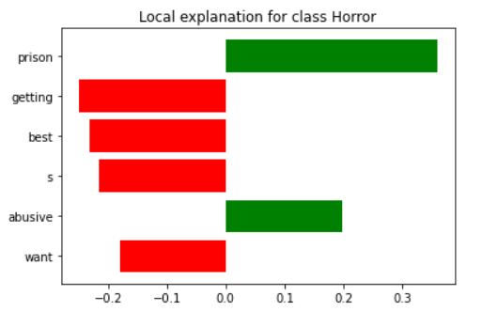
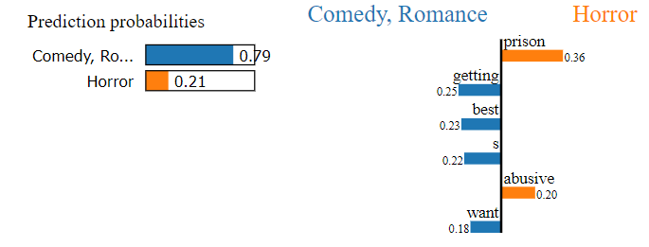
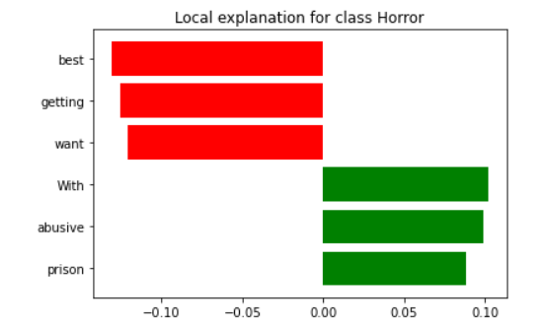
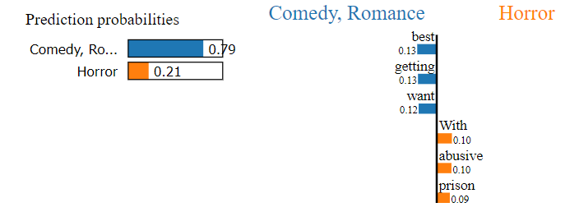

Slide 8
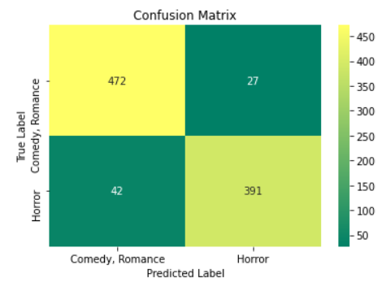
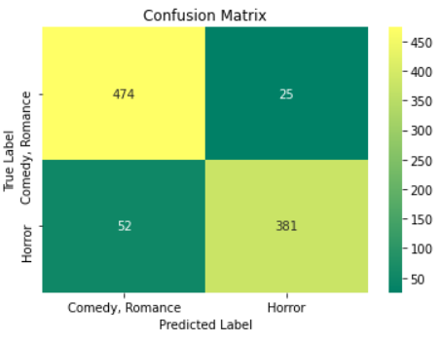
Naïve bayes – TF-IDF
Logistic Regression– TF-IDF
Horror and Comedy, Romance

Slide 9
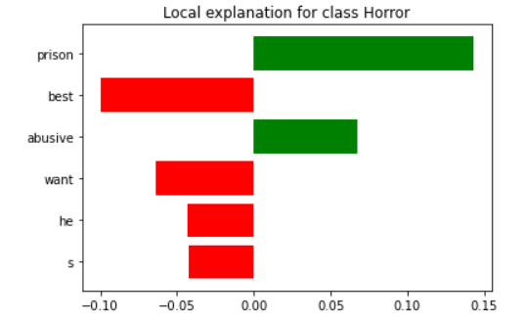
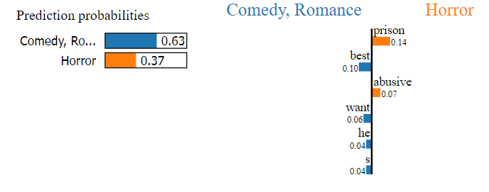
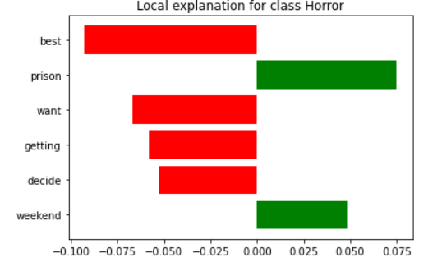
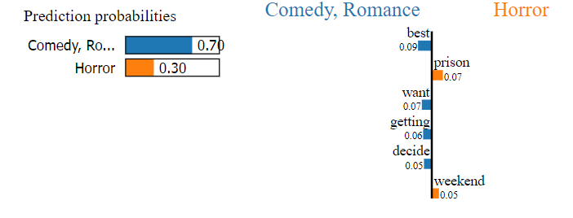

Slide 10
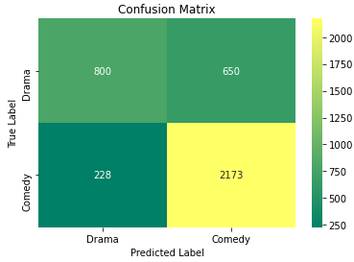
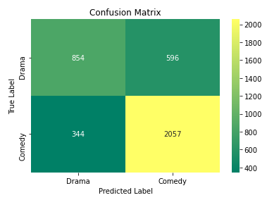
Naïve bayes – counter Vectorizer
Logistics Regression – counter Vectorizer
Comedy and Drama

Slide 11
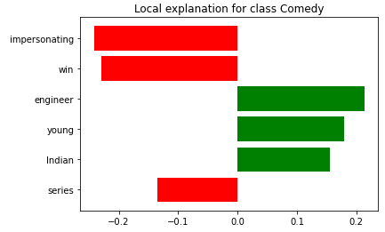
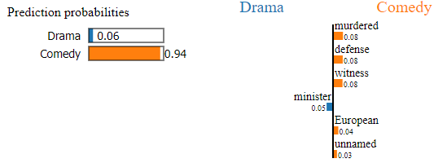
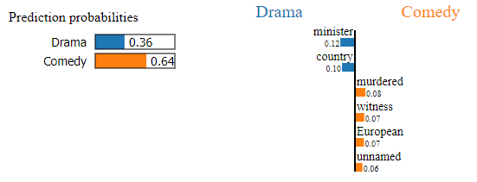
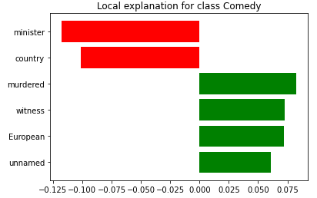

Slide 12
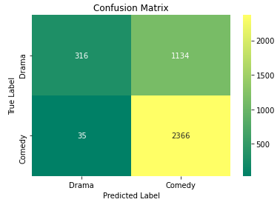
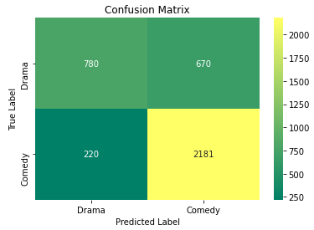
Naïve bayes – TF-IDF
Logistics Regression – TF-IDF
Comedy and Drama

Slide 13
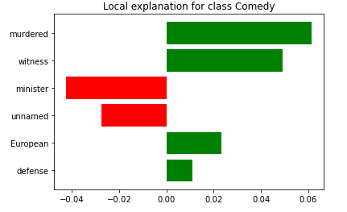
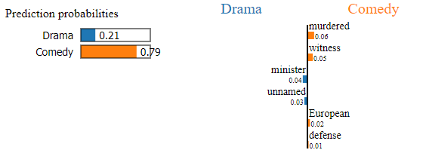
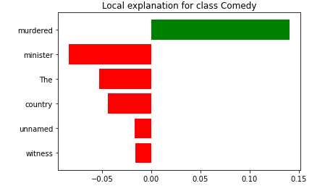
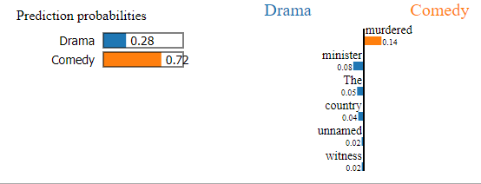

Slide 14
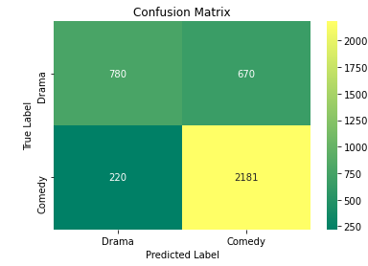
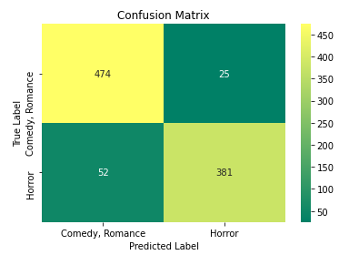
[Horror and Comedy, Romance] vs. [Drama and Comedy]
In the first matrix the accuracy is lower than the second matrix, because the first one has more data in it and be over fitted, and the accuracy sometimes can get lower and sometimes it can increase accuracy, it must be monitored and see how data will react we adjusting the amount of data and the test trails

Slide 15
Conclusion
While working on the model the TFID performed the best in two movie genre category
The Logistic Regression algorithm in all test performed the best by giving the best accuracy

Slide 16
Future work and Obstacle
While working on this project the only obstacle I came across was selecting the data sets to train the AI with. I had to find a query statement to make sure it will select the data sets that is desired
For future work, I suggest using another database or data sets with more cleaned an organized data in it

